Slide 1

The Feed Grain Atlas Report
Presented by:
BHOOMIKA MUDEGOWDRU LINGARAJU
Northeastern University
Boston

Slide 2
INTRODUCTION :
The dataset tracks the imports and exports of corn and other products in the U.S., for example, in different time periods (e.g., annual, monthly) and details related to geography, commodity, units, and the year. The Amount column measures the quantity of trade in terms of 1,000 metric tons.
Use-Case:
Random Forest to look at factors influencing the price of bushels, such as market conditions, economic factors, or supply chain influences.
SARIMA to examine seasonal patterns or time-based trends in price prediction. to forecast based on historical price trends, particularly when pricing is influenced by annual cycles (e.g., seasonal agricultural yields)

Slide 3
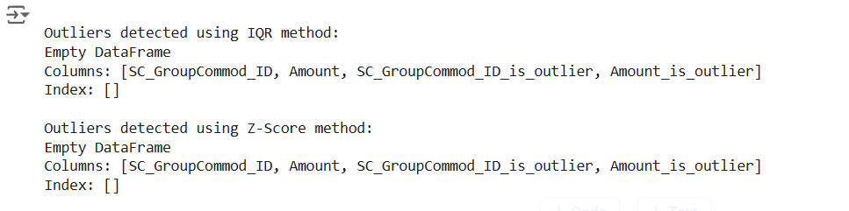
DATA DICTIONARY (EDA) :
As part of the data exploration process, the variable types and generated descriptive statistics were examined to better understand the dataset.
The original feed grains dataset consists of 521,508 observations across 19 variables.
During the exploration, 7,414 missing entries were identified which is around 1.5%, all of which are associated with the 'Group Commodity ID' and the ‘Group Commodity Description’ variables. There were no duplicate rows in the dataset, and overall, the data appears to be in good condition with only a small amount of missing.
Outliers were detected in the dataset using both the IQR (Interquartile Range) and Z-score methods.
The Amount variable showed a skewed distribution with significant outliers, indicating rare or high-value transactions. Identifying these anomalies is crucial as they can impact analysis, signal data errors, or highlight exceptional business scenarios.

Slide 4
FEATURE ENGINEERING:
Filtered the dataset: Kept only rows where 'SC_Frequency_Desc' equals 'Monthly'.
Dropped unnecessary columns: Removed columns including 'SC_Group_ID', 'SC_GroupCommod_ID', 'SC_Commodity_ID', and others to reduce dimensionality.
Created a 'Season' column: Derived the 'Season' feature based on the 'Timeperiod_Desc' column, classifying months into Winter, Spring, Summer, and Fall.
Dropped irrelevant columns: Removed 'SC_Frequency_Desc', 'SC_Group_Desc', and 'SC_GroupCommod_Desc' after creating the new features.

Slide 5
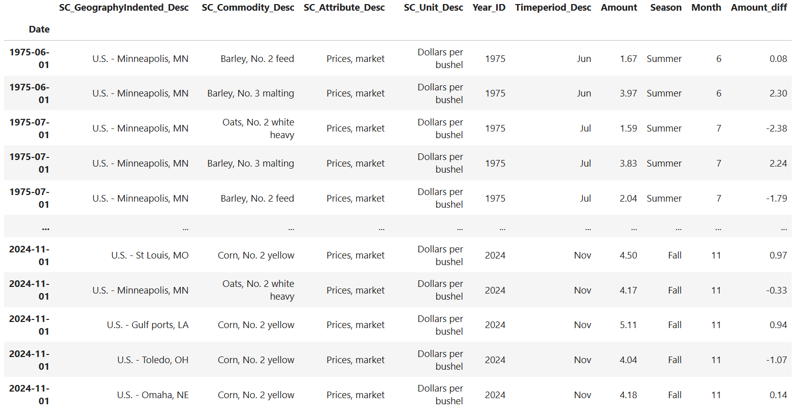
KEY DIFFERENCES:
Commodity Price Tracking: The dataset records that we are looking at are market prices of agricultural commodities (e.g., Barley, Brewers grits) across different U.S. locations, filtered to units like Dollars per bushel or Dollars per cwt.
Regional Focus: Instead of international trade data, the dataset focuses on specific U.S. regions such as Golden Triangle, MT, and New York, NY, providing localized insights into commodity pricing.
Seasonal Categorization: A "Season" column has been added, classifying months into Summer, Fall, Winter, and Spring, helping analyze seasonal price variations of commodities.
Yearly and Monthly Data Representation: The dataset covers multiple years (1975-2024) and provides monthly price trends, allowing for time-series analysis of commodity price fluctuations.
Granular Price Details: The "Amount" column represents precise price values with two decimal places, ensuring higher accuracy in financial and economic analysis.

Slide 6
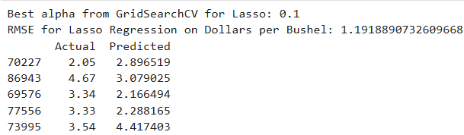
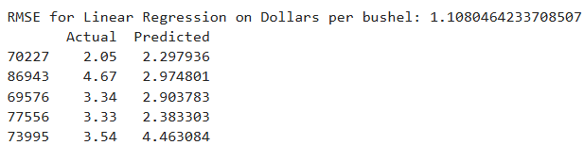
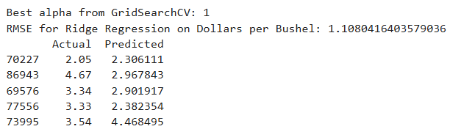
PREDICTIVE MODELING:
The dataset contains different units of price measurement, including 'Dollars per bushel,' 'Dollars per cwt,' and 'Cents per pound,' indicating variations in pricing standards across commodities.
Dollars per bushel
Lasso Regression Model Performance
Linear Regression Model Performance
Hyperparameter Tuning with GridSearchCV

Slide 7
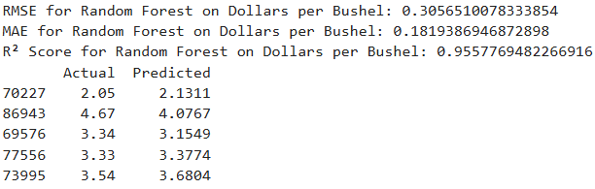
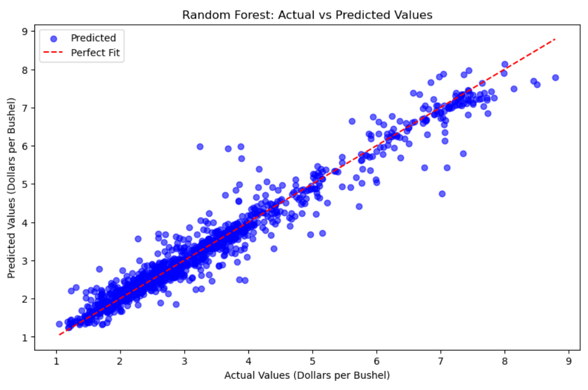
RANDOM FOREST MODELS :
Dollars per Bushel
Performance of Random Forest on Dollars per Bushel
RMSE: 0.305, MAE: 0.1819, R² Score: 0.955, with actual and predicted values demonstrating strong accuracy for “Dollars per Bushel’’
The RMSE of 0.305 indicates the overall model's efficiency in predicting values across the dataset
Commonly used for grains, such as corn, wheat, and soybeans.
Dataset involving agricultural commodities like these, dollars per bushel would be the most suitable and commonly understood pricing unit.

Slide 8
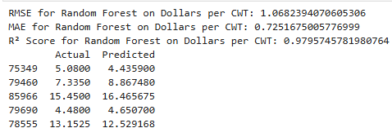
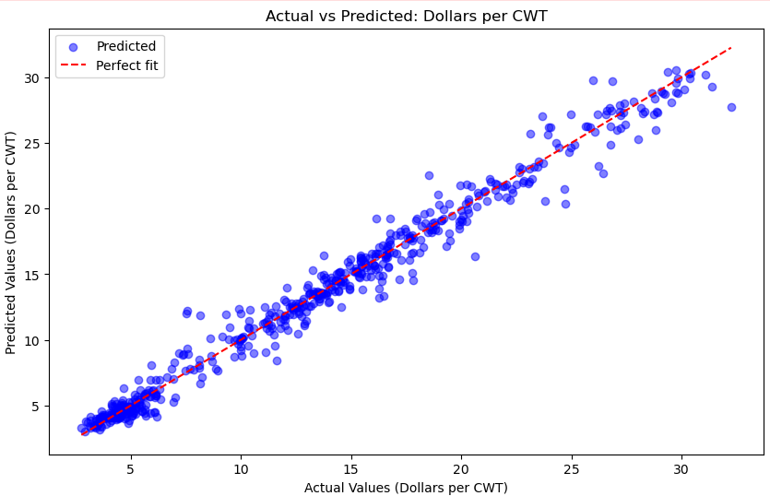
Dollars per cwt
Performance of Random Forest on Dollars per CWT
RMSE: 1.068, MAE: 0.725, R² Score: 0.980, with actual and predicted values demonstrating strong accuracy for “Dollars per CWT’’
The RMSE of 1.068 indicates the overall model's efficiency in predicting values across the dataset
Used for livestock and other bulk commodities like meat or dairy products (e.g., cattle, hogs, milk).
If you're working with livestock or products sold by weight in large quantities, this would be more suitable.

Slide 9
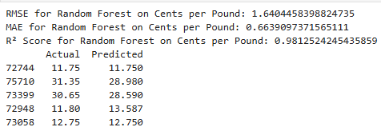
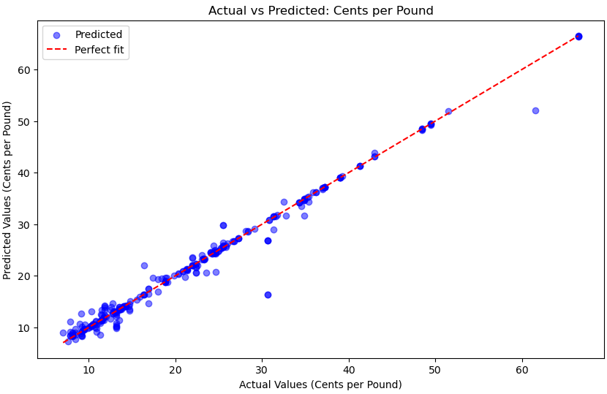
Cents per pound
Performance of Random Forest on Cents per Pound
RMSE: 1.640, MAE: 0.664, R² Score: 0.981, showcasing high accuracy in predicting "Cents per Pound" values with minimal error
RMSE of 1.733 indicates the overall predictive capability of the Random Forest model across the dataset.
Common for commodities like cocoa, coffee, and other food products that are sold in smaller, consumer quantities.
If you're looking at pricing for smaller items, this might be appropriate.

Slide 10
TIME SERIES ANALYSIS:
Time Representation: The old dataset used broader time periods like "MY Sep-Aug" or individual months while the new dataset uses more precise date representations, such as "1975-06-01" for specific days.
Data Columns: The new dataset has a new column, "Date," which represents the exact date of the entry, whereas the old dataset lacks this granularity, focusing instead on months and years
Set the date column as index for time series analysis

Slide 11
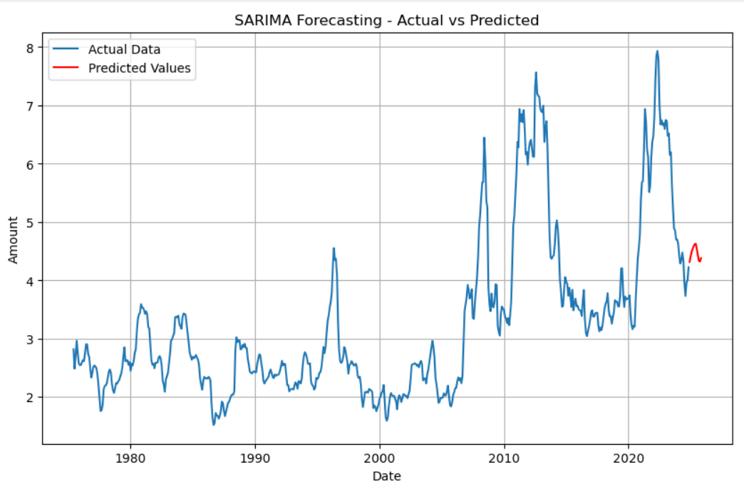
SARIMA FORECASTING:
Comparison of Actual and Predicted Data: The blue line represents the actual historical data, while the red line shows the SARIMA model's predicted values, indicating a slight upward trend after a sharp decline in recent years.
Seasonality and Trends: The actual data displays clear fluctuations with multiple peaks and troughs, and the SARIMA model effectively captures these seasonal variations and long-term trends to forecast future values.

Slide 12
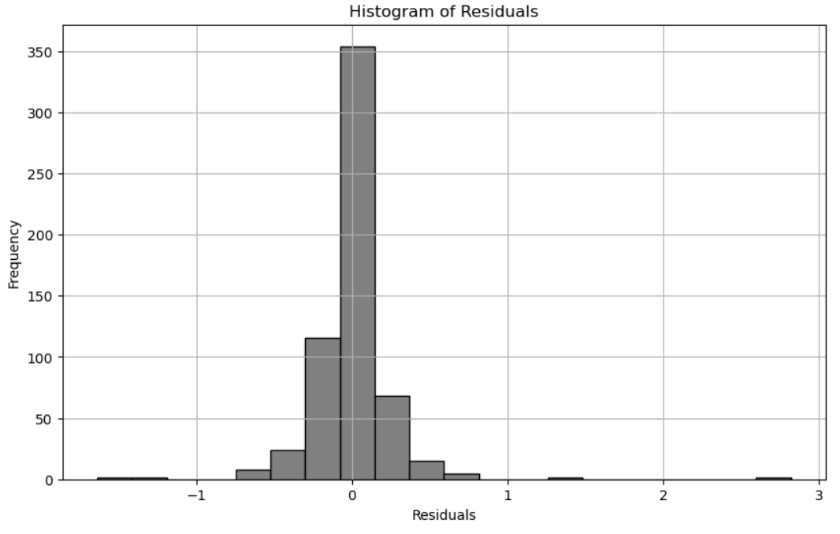
HISTOGRAM OF RESIDUALS:
Symmetry Around Zero: The histogram is centered around 0, indicating that the residuals are symmetrically distributed. This suggests that the model's predictions are unbiased, with errors evenly distributed around the true values.
Normality of Residuals: The shape of the histogram resembles a bell curve, which implies that the residuals may follow a normal distribution. This is a desirable property in many regression models, as it validates assumptions about error distribution.
Concentration Near Zero: Most residuals are clustered close to 0, indicating that the model's predictions are generally accurate, with only a few large deviations.

Slide 13
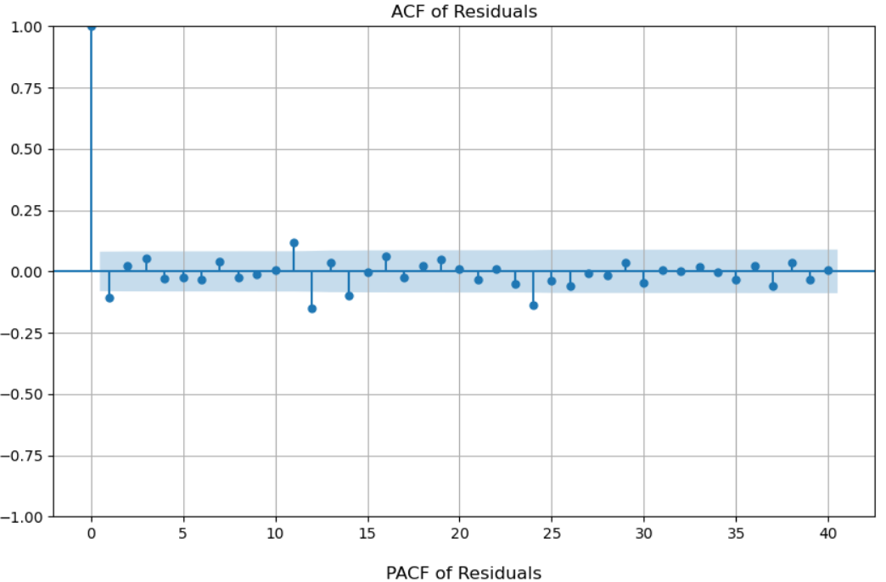
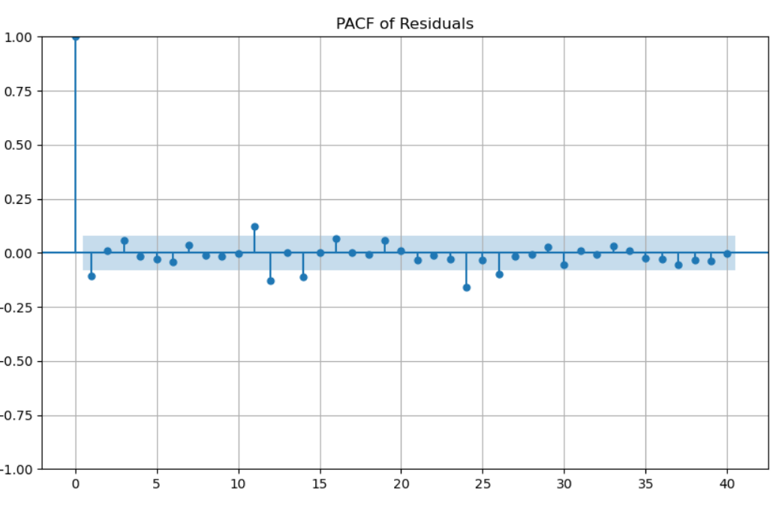
ACF AND PACF RESIDUALS:
Both plots together indicate that the model is adequate for the data. The lack of significant spikes outside the confidence intervals implies that there are no remaining autocorrelations or patterns in the residuals, validating that the model fits well and does not leave systematic errors unexplained.

Slide 14
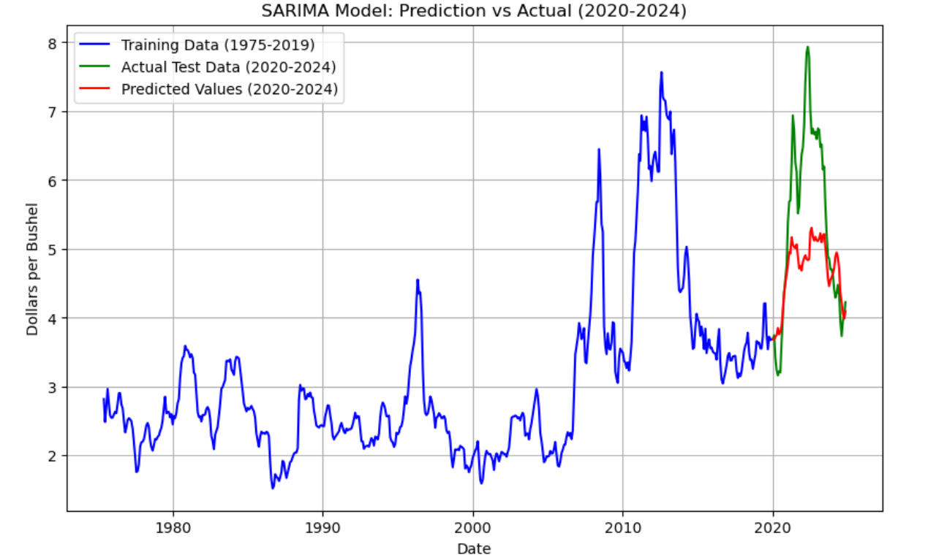
SARIMA MODEL:
The predicted values align closely with the historical trend but it is not able to capture spike trends, showing that the SARIMA model might need additional variables such as weather data, market demand, economic indicators, and production costs, though deviations or external factors should be considered when interpreting the results.
The next steps should focus on refining the current Random Forest and SARIMA models.

Slide 15
ADFULLER TEST:
Interpretation:
The p-value of 0.0611 is slightly greater than 0.05.
This suggests that the null hypothesis (that the series has a unit root, i.e., it's non-stationary) cannot be rejected at the 5% significance level. In other words, the data is likely non-stationary before differencing.
Interpretation:
The p-value of 1.5428e-07 is much smaller than 0.05.
This indicates strong evidence to reject the null hypothesis, suggesting that the differenced series is stationary.
The ADF Statistic of -6.0148 is also more negative, further supporting the rejection of the null hypothesis.
Conclusion:
Before differencing: The time series is non-stationary as indicated by the p-value of 0.0611 (greater than 0.05).
After differencing: The time series is now stationary with a p-value of 1.5428e-07 (significantly less than 0.05), which means the differenced series no longer exhibits a unit root.

Slide 16
CONCLUSION:
To improve the forecasting of dollars per bushel, the next steps should focus on refining the current Random Forest and SARIMA models
Incorporating additional variables such as weather data, market demand, economic indicators, and production costs
Exploring SARIMAX (SARIMA with exogenous variables) will allow us to capture the influence of these factors
Cross-validation to ensure the models generalize well, while scenario analysis and confidence intervals will provide insights into the uncertainty of predictions
Recommendations:
Based on the model results, the business should use the forecasts to:
Optimize pricing strategies
Plan for seasonal variations
Improve risk management by accounting for uncertainty in price predictions
Explore market expansion, adjust its supply chain strategy based on price trends,
and enhance communication with stakeholders
By leveraging these insights, the company can make more informed decisions, improve operational efficiency, and increase profitability.

Slide 17
REFERENCES:
https://www.ers.usda.gov/data-products/feed-grains-database/feed-grains-yearbook-tables#Zipped%20CSV%20files
https://www.geeksforgeeks.org/hyperparameter-tuning/
https://www.datasciencecentral.com/decision-tree-vs-random-forest-vs-boosted-trees-explained/
https://scikit-learn.org/1.6/modules/generated/sklearn.model_selection.GridSearchCV.html
https://www.analyticsvidhya.com/blog/2016/02/complete-guide-parameter-tuning-gradient-boosting-gbm-python/
https://scikit-learn.org/1.5/modules/generated/sklearn.ensemble.RandomForestClassifier.html

